Slide 1


Slide 2
6.1: Multi File Development
CS2308
Gentry Atkinson

Slide 3
Why split up a program?
Very large files can be hard to read.
Putting many classes and function in one file can be confusing.
We might not distribute source code to protect IP.

Slide 4
Including User Defined Libraries
We can still use the #include pre-processor directive to use our own libraries.
Only header (.h) files need to be included.
Use the full filename to include a local library (e.g. “myClass.h”)

Slide 5
How are programs divided in OOP?
Put each class definition in a separate header file.
  The extension of a header is .h
Put the implementation of each class in a separate .cpp file.
Every program needs a main.cpp driver.

Slide 6
Example 1
In Employee.h
class Employee{
private:
string name;
string title;
float hourlyRate;
public:
Employee();
Employee(const Employee&);
};
In Employee.cpp
Employee::Employee(){
name = "";
title = "";
hourlyRate = 0;
}
Employee::Employee(const Employee& e){
name = e.name;
title = e.title;
hourlyRate = e.hourlyRate;
}

Slide 7
Using local libraries
Once a library is included in your program, you can use any functions or classes as if they were defined in the same file.
You should have a “main.cpp” with a main function. This is called a driver.

Slide 8
Example 2
In main.cpp
#include<iostream>
#include “Employee.h”
using namespace std;
int main(int argc, char** argv){
Employee a;
Employee b(a);
cout << "Opps. No getters." << endl;
} //try to guess the output

Slide 9
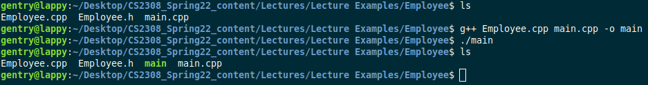
Compiling Multiple Files
g++ can be used to compile multiple files at once.
Only .cpp files need to be compiled.

Slide 10
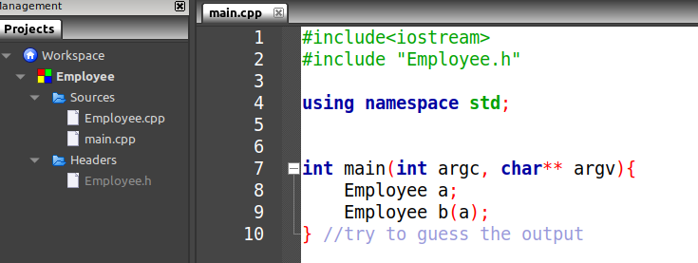
Compiling Multiple Files
A CodeBlocks project can be used to manage multiple code files.
Use Project→add files… to incorporate files into an empty project.

Slide 11
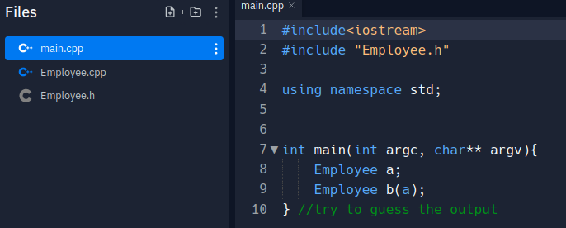
Compiling Multiple Files
Use “Add File” to create a new blank file in Replit or “Upload File” to add a local file.
Running a project will automatically link files.

Slide 12
Just Remember...
Only one main.cpp or main function can be defined in a project.
Never #include a .cpp file.
The implementation file should #include the the header file
  E.g. example.cpp should #include example.h

Slide 13
Questions or Comments?

